Slide 1

Chapters 20, 21
Testing Hypotheses
about Proportions
1

Slide 2
Example
Cellphone companies have discovered that college students, their biggest customers, have difficulty setting up all the features of their smart phones, so they have developed what they hope are simpler instructions.
The goal is to have at least 96% of customers succeed. The new instructions are tested on 200 students, of whom 188 (94%) were successful.
Is this evidence that the new instructions fail to meet the companies’ goal?

Slide 3
The Dow Jones Industrial Average closing prices for the bull market 1982-1986:
3
Notes:
QTM1310/ Sharpe
3

Slide 4
QUESTION: Is the Dow just as likely to move higher as it is to move lower on any given day?
Out of the 1112 trading days in that period, the average increased on 573 days (sample proportion = 0.51530.
That is more “up” days than “down” days.
But is it far enough from 0.50 to cast doubt on the assumption of equally likely up or down movement?
4
Notes:
QTM1310/ Sharpe
4

Slide 5
Rigorous Evaluation of the data: Hypothesis Testing
To test whether the daily fluctuations are equally likely to be up as down, we assume that they are, and that any apparent difference from 50% is just random fluctuation.
5
Notes:
QTM1310/ Sharpe
5

Slide 6
Hypotheses
In its simplest form, a hypothesis is a claim or statement about the value of a single population parameter.
The following are examples of hypotheses about population proportions:
Hypotheses are ALWAYS statements about the population characteristic – NEVER the sample statistic.
Hypothesis | Population Proportion of Interest | The Hypothesis says . . .
p < 0.25 | Where p is the proportion of e-mail messages that included an attachment | Less than 25% of the e-mail messages sent included an attachment
p > 0.8 | Where p is the proportion of e-mail messages that were longer than 500 characters | More than 80% of the e-mail messages sent were longer than 500 characters
p = 0.3 | Where p is the proportion of e-mail messages that were sent to multiple recipients | 30% of the e-mail messages sent were sent to multiple recipients

Slide 7
Hypothesis statements:
The null hypothesis, denoted by H₀, specifies a population model parameter and proposes a value for that parameter
The alternative hypothesis, denoted by H_{a}, is the competing claim.
Two possible conclusions in a hypothesis test are:
Reject H₀
Fail to reject H₀
In carrying out a test of H₀ versus H_{a}, the null hypothesis H₀ is rejected in favor of the alternative hypothesis H_{a} ONLY if the sample data provide convincing evidence that H₀ is false.
If the sample data do not provide such evidence, H₀ is not rejected.
Notice that the conclusions are made about the null hypothesis NOT about the alternative!

Slide 8
The Form of Hypotheses:
This one is considered a two-tailed test because you are interested in both directions.
Null hypothesis
H₀: population characteristic = hypothesized value
Alternative hypothesis
H_{a}: population characteristic > hypothesized value
H_{a}: population characteristic < hypothesized value
H_{a}: population characteristic ≠ hypothesized value
The null hypothesis always includes the equal case.
This hypothesized value is a specific number determined by the context of the problem
This sign is determined by the context of the problem.
Notice that the alternative hypothesis uses the same population characteristic and the same hypothesized value as the null hypothesis.
These are considered one-tailed tests because you are only interested in one direction.
Let’s practice writing hypothesis statements.

Slide 9

In a study, researchers were interested in determining if sample data support the claim that more than one in four young adults live with their parents.
Define the population parameter:
p = the proportion of young adults who
live with their parents
It is acceptable to write the null hypothesis as:
H₀: p ≤ 0.25
State the hypotheses :
What is the hypothesized value?
H₀: p = 0.25
H_{a}: p > 0.25
What words indicate the direction of the alternative hypothesis?

Slide 10
A study included data from a survey of 1752 people ages 13 to 39. One of the survey questions asked participants how satisfied they were with their current financial situation. Suppose you want to determine if the survey data provide convincing evidence that fewer than 10% of adults 19 to 39 are very satisfied with their current financial situation.
Define the population parameter:
p = the proportion of adults ages 19 to 39 who are very satisfied with their current financial situation
State the hypotheses :
What words indicate the direction of the alternative hypothesis?
H₀: p = 0.10
H_{a}: p < 0.10

Slide 11

The manufacturer of M&Ms claims that 40% of plain M&Ms are brown. A sample of M&Ms will be used to determine if the proportion of brown M&Ms is different from what the manufacturer claims.
Define the population parameter:
p = the proportion of plain M&Ms that are brown
State the hypotheses :
What words indicate the direction of the alternative hypothesis?
H₀: p = 0.40
H_{a}: p ≠ 0.40

Slide 12
For each pair of hypotheses, indicate which are not legitimate and explain why
Must use a population characteristic!
H_{a} does NOT include equality statement!
Must use same number as in H₀!
H₀ MUST include the equality statement!

Slide 13
Back to the Dow Jones Industrial Average Example: Null Hypothesis H₀
The null hypothesis, H₀, specifies a population model parameter and proposes a value for that parameter.
Recall that we usually write a null hypothesis about a proportion in the form H₀: p = p₀.
For our hypothesis about the DJIA, we need to test
H₀: p = 0.5
where p is the proportion of days that the DJIA goes up.
13
Notes:
QTM1310/ Sharpe
13

Slide 14
Alternative Hypothesis
The alternative hypothesis, H_{A}, contains the values of the parameter that we consider plausible if we reject the null hypothesis.
We are usually interested in establishing the alternative hypothesis H_{A}. We do so by looking for evidence in the data against H₀.
Our alternative is H_{A}: p ≠ 0.5.
14
Notes:
QTM1310/ Sharpe
14

Slide 15
Recall: One-sided and two-sided tests
A two-tail or two-sided test of the population proportion has these null and alternative hypotheses:
H₀ : p = p₀ [p₀ is a specific proportion] H_{a} : p ≠ p₀ [p₀ is a specific proportion]
A one-tail or one-sided test of a population proportion has these null and alternative hypotheses:
H₀ : p = p₀ [p₀ is a specific proportion] H_{a} : p < p₀ [p₀ is a specific proportion]
OR
H₀ : p = p₀ [p₀ is a specific proportion] H_{a} : p > p₀ [p₀ is a specific proportion]

Slide 16
DJIA Hypotheses
The null and alternative hypotheses are ALWAYS stated in terms of a population parameter.
H₀: p = p₀ H₀: p = 0.5
H_{A}: p ≠ p₀ H_{A}: p ≠ 0.5
This is a 2-sided test.
What would convince you that the proportion of up days was not 0.5?
What sample statistic to use?
Test statistic: a number calculated from the sample statistic
  the test statistic measures how far is from p₀ in standard deviation units
  If is too far away from p₀ , this is evidence against
  H₀: p = p₀
16
Notes:
QTM1310/ Sharpe
16

Slide 17
The Test Statistic for a one-proportion z-test
Since we are performing a hypothesis test about a proportion p, this test about proportions is called a one-proportion z-test.
17
Notes:
QTM1310/ Sharpe
17

Slide 18
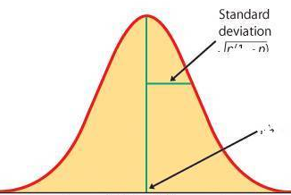
Calculating The Test Statistic
The sampling distribution for is approximately normal for large sample sizes and its shape depends solely on p and n.
Thus, we can easily test the null hypothesis:
H₀: p = p₀ (p₀ is a specific value of p for which we are testing).
If H₀ is true, the sampling distribution of
is known:
How far our sample proportion is from from p₀ in units of the standard deviation is calculated as follows:
This is valid when both expected counts — expected successes np₀ and expected failures
n(1 − p₀) — are each 10 or larger.

Slide 19
DJIA Test Statistic
H₀: p = 0.5 n = 1112 days; market was “up” 573 days
H_{A}: p ≠ 0.5
Calculating the test statistic z:
To evaluate the value of the test statistic, we calculate the corresponding P-value
19
Notes:
QTM1310/ Sharpe
19

Slide 20
P-Values: Weighing the evidence in the data against H₀
The P-value is the probability, calculated assuming the null hypothesis H₀ is true, of observing a value of the test statistic more extreme than the value we actually observed.
The calculation of the P-value depends on whether the hypothesis test is 1-tailed
(that is, the alternative hypothesis is H_{A} :p < p₀ or H_{A} :p > p₀)
or 2-tailed
(that is, the alternative hypothesis is H_{A} :p ≠ p₀).
20
Notes:
QTM1310/ Sharpe
20

Slide 21
P-Values
Assume the value of the test statistic z is z₀
If H_{A}: p > p₀, then P-value=P(z > z₀)
If H_{A}: p < p₀, then P-value=P(z < z₀)
If H_{A}: p ≠ p₀, then P-value=2P(z >|z₀|)
21
Notes:
QTM1310/ Sharpe
21

Slide 22
Interpreting P-Values
The P-value is the probability, calculated assuming the null hypotheis H₀ is true, of observing a value of the test statistic more extreme than the value we actually observed.
A small P-value is evidence against the null hypothesis H₀.
  A small P-value says that the data we have observed would be very unlikely if our null hypothesis were true. If you believe in data more than in assumptions, then when you see a low P-value you should reject the null hypothesis.
A large P-value indicates that there is little or no evidence in the data against the null hypothesis H₀ .
  When the P-value is high (or just not low enough), data are consistent with the model from the null hypothesis, and we have no reason to reject the null hypothesis. Formally, we say that we “fail to reject” the null hypothesis.
22
Notes:
QTM1310/ Sharpe
22

Slide 23

Interpreting P-Values
The P-value is the probability, calculated assuming the null hypotheis H₀ is true, of observing a value of the test statistic more extreme than the value we actually observed.
When the P-value is LOW, the null hypothesis must GO.
How small does the P-value need to be to reject H₀ ?
Usual convention:
the P-value should be less than .05 to reject H₀
If the P-value > .05, then conclusion is “do not reject H₀”
23
Notes:
QTM1310/ Sharpe
23

Slide 24
DJIA HypothesisTest P-value (cont.)
H₀: p = 0.5 n = 1112 days; market was “up” 573 days
H_{A}: p ≠ 0.5
Since the P-value is greater than .05, our conclusion is “do not reject the null hypothesis”; there is not sufficient evidence to reject the null hypothesis that the proportion of days on which the DJIA goes up is .50
24
Notes:
QTM1310/ Sharpe
24

Slide 25
DJIA HypothesisTest P-value (cont.)
This is the probability of observing more than 51.53% up days (or more than 51.53% down days) if the null hypothesis H₀ p=.5 were true.
In other words, if the chance of an up day for the Dow is 50%, we’d expect to see stretches of 1112 trading days with as many as 51.53% up days about 15.4% of the time and with as many as 51.53% down days about 15.4% of the time. That’s not terribly unusual, so there’s really no convincing evidence to reject H₀ p=.5.
Conclusion:
Since the P-value is greater than .05, our conclusion is “do not reject the null hypothesis”; there is not sufficient evidence to reject the null hypothesis that the proportion of days on which the DJIA goes up is .50
25
Notes:
QTM1310/ Sharpe
25

Slide 26
A Trial as a Hypothesis Test
We started by assuming that the probability of an “up” day was .50
Then we looked at the data and concluded that we couldn’t say otherwise because the proportion that we actually observed wasn’t far enough from .50
This is the logic of jury trials. In British common law, the null hypothesis is that the defendant is not guilty (“innocent until proven guilty”)
H₀ : defendant is innocent; H_{A} : defendant is guilty
The government has to prove your guilt, you do NOT have to prove your innocence.
The evidence takes the form of facts that seem to contradict the presumption of innocence. For us, this means collecting data.
26
Notes:
QTM1310/ Sharpe
26

Slide 27
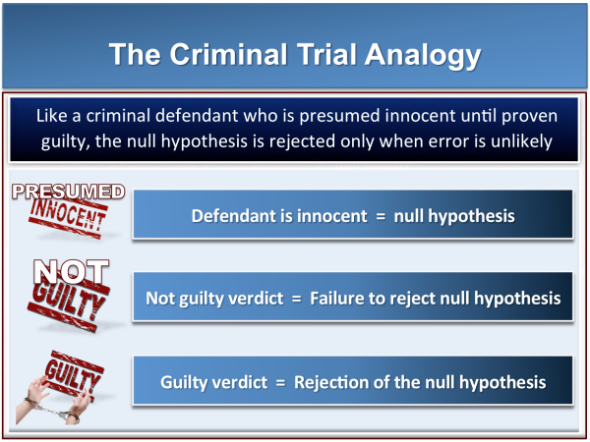
P-Values and Trials
H₀: defendant innocent;
H_{A}: defendant guilty
If there is insufficient evidence to convict the defendant (if the P-value is not low), the jury does NOT accept the
null hypothesis and declare that the defendant is “innocent”. Juries can only fail to reject the null hypothesis and declare the defendant “not guilty.”
Possible verdicts
In the same way, if the data are not particularly unlikely under the assumption that the null hypothesis is true, then our conclusion is “fail to reject H₀”, not “accept H₀”.
27
Notes:
QTM1310/ Sharpe
27

Slide 28
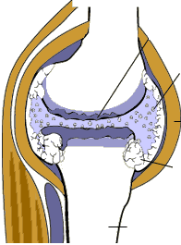
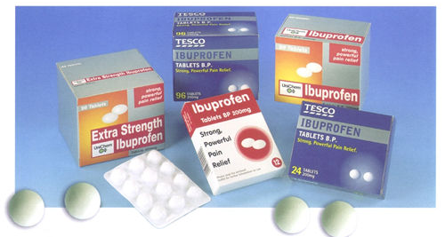
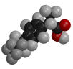
Medication side effects (hypothesis test for p)
Arthritis is a painful, chronic inflammation of the joints.
An experiment on the side effects of the pain reliever ibuprofen examined arthritis patients to find the proportion of patients who suffer side effects. If more than 3% of users suffer side effects, the FDA will put a stronger warning label on packages of ibuprofen
Serious side effects (seek medical attention immediately):
Allergic reaction (difficulty breathing, swelling, or hives),
Muscle cramps, numbness, or tingling,
Ulcers (open sores) in the mouth,
Rapid weight gain (fluid retention),
Seizures,
Black, bloody, or tarry stools,
Blood in your urine or vomit,
Decreased hearing or ringing in the ears,
Jaundice (yellowing of the skin or eyes), or
Abdominal cramping, indigestion, or heartburn,
Less serious side effects (discuss with your doctor):
Dizziness or headache,
Nausea, gaseousness, diarrhea, or constipation,
Depression,
Fatigue or weakness,
Dry mouth, or
Irregular menstrual periods
What are some side effects of ibuprofen?

Slide 29

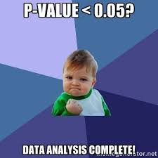
440 subjects with chronic arthritis were given ibuprofen for pain relief; 23 subjects suffered from adverse side effects.
H₀ : p =.03 H_{A} : p > .03 where p is the proportion of ibuprofen
users who suffer side effects.
Test statistic:
P-value:
Conclusion: since the P-value is less than .05, reject H₀ : p =.03; there is sufficient evidence to conclude that the proportion of ibuprofen users who suffer side effects is greater than .03

Slide 30
Example: one-proportion z test
A marketing company claims that it receives 8% responses from its mailing. To test this claim, a random sample of 500 were surveyed with 25 responses. Perform a 2-sided hypothesis test to evaluate the company’s claim
Check:
n p = (500)(.08) = 40
n(1-p) = (500)(.92) = 460
✓

Slide 31
Solution
H₀: p = .08 H_{A}: p ≠ .08
Test Statistic:
Decision: Since P-value < .05, Reject H₀
Conclusion:
.0068
.0068
There is sufficient evidence to reject the company’s claim of 8% response rate.
z
-2.47
0
2.47

Slide 32
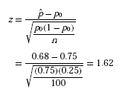
Example: one-proportion z test
A national survey by the National Institute for Occupational Safety and Health on restaurant employees found that 75% said that work stress had a negative impact on their personal lives.
You investigate a restaurant chain to see if the proportion of all their employees negatively affected by work stress differs from the national proportion p₀ = 0.75.
H₀: p = p₀ = 0.75 vs. H_{a}: p ≠ 0.75 (2 sided alternative)
In your SRS of 100 employees, you find that 68 answered “Yes” when asked, “Does work stress have a negative impact
on your personal life?”
The expected counts are 100 × 0.75 = 75 and 25.
Both are greater than 10, so we can use the z-test.
The test statistic is:

Slide 33

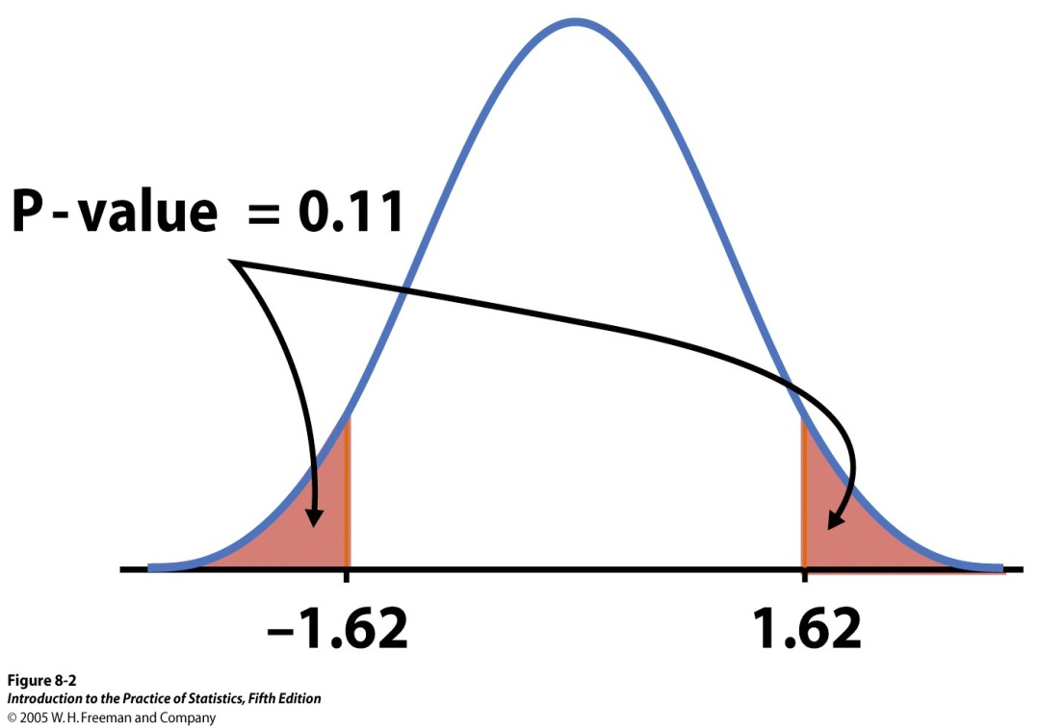
From Table Z we find the area to the left of z= 1.62 is 0.9474.
Thus P(Z ≥ 1.62) = 1 − 0.9474, or 0.0526. Since the alternative hypothesis is two-sided, the P-value is the area in both tails, so
P –value = 2 × 0.0526 = 0.1052 ≅ 0.11.
➔ The chain restaurant data are not significantly different from the national survey results (pˆ = 0.68, z = 1.62, P = 0.11).

